Slide 1
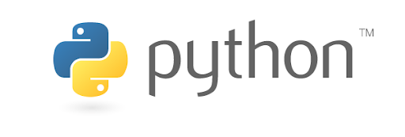
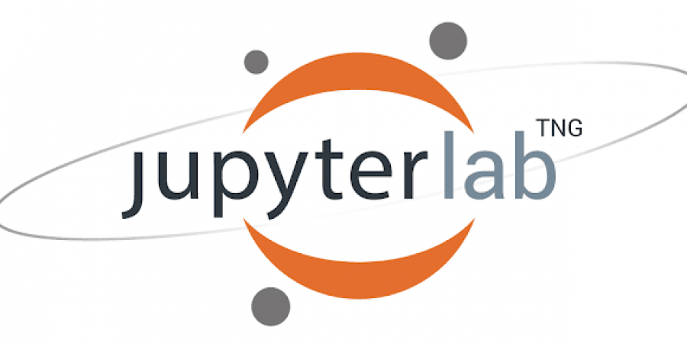
Python Basics
Freddy Carrión M.
Abril 2024

Slide 2
Outline
Python Fundamentals (5 min)
Part 1 - Data Structures (1 hr 15 min)
- 1.0. Introduction
- 1.1. Data Types
- 1.2. Lists
- 1.3. Lists manipulation
- 1.4. Dictionaries
- 1.5. Dictionaries manipulation
Test Part 1 (15 min)
Part 2 - Compound Statements (1 hr)
- 2.1. Conditionals (if, else, elif)
- 2.2. Loops (for, while)
- 2.3. Functions
Test Part 2 (15 min)

Slide 3
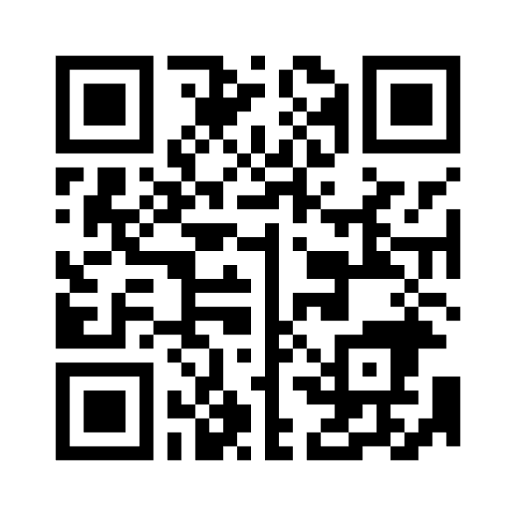
https://www.menti.com/alyxef4667g4

Slide 4
Python Fundamentals

Slide 5
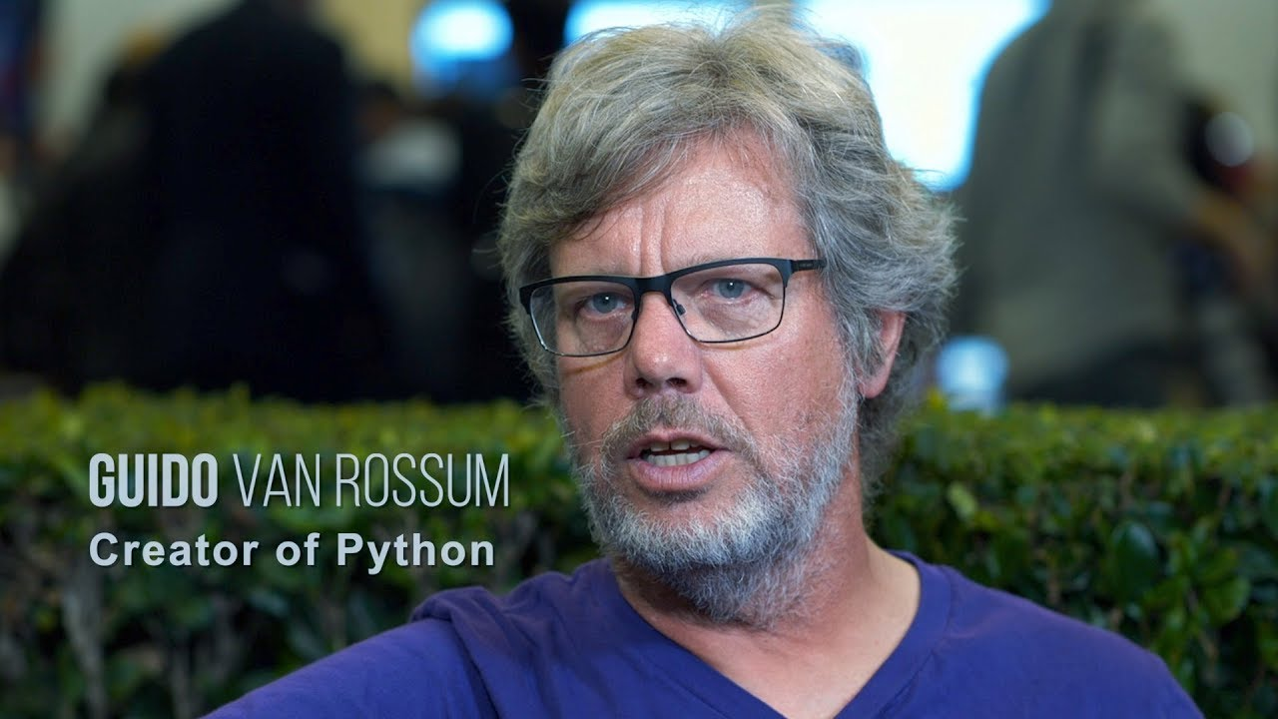
History of Python
Python is a high-level general-purpose programming language. Its design philosophy emphasizes code readability with the use of significant indentation. Its language constructs and object-oriented approach aim to help programmers write clear, logical code for small- and large-scale projects.
It was created by the Dutch programmer Guido van Rossum in 1991.
Figure 1. Creator of Python

Slide 6
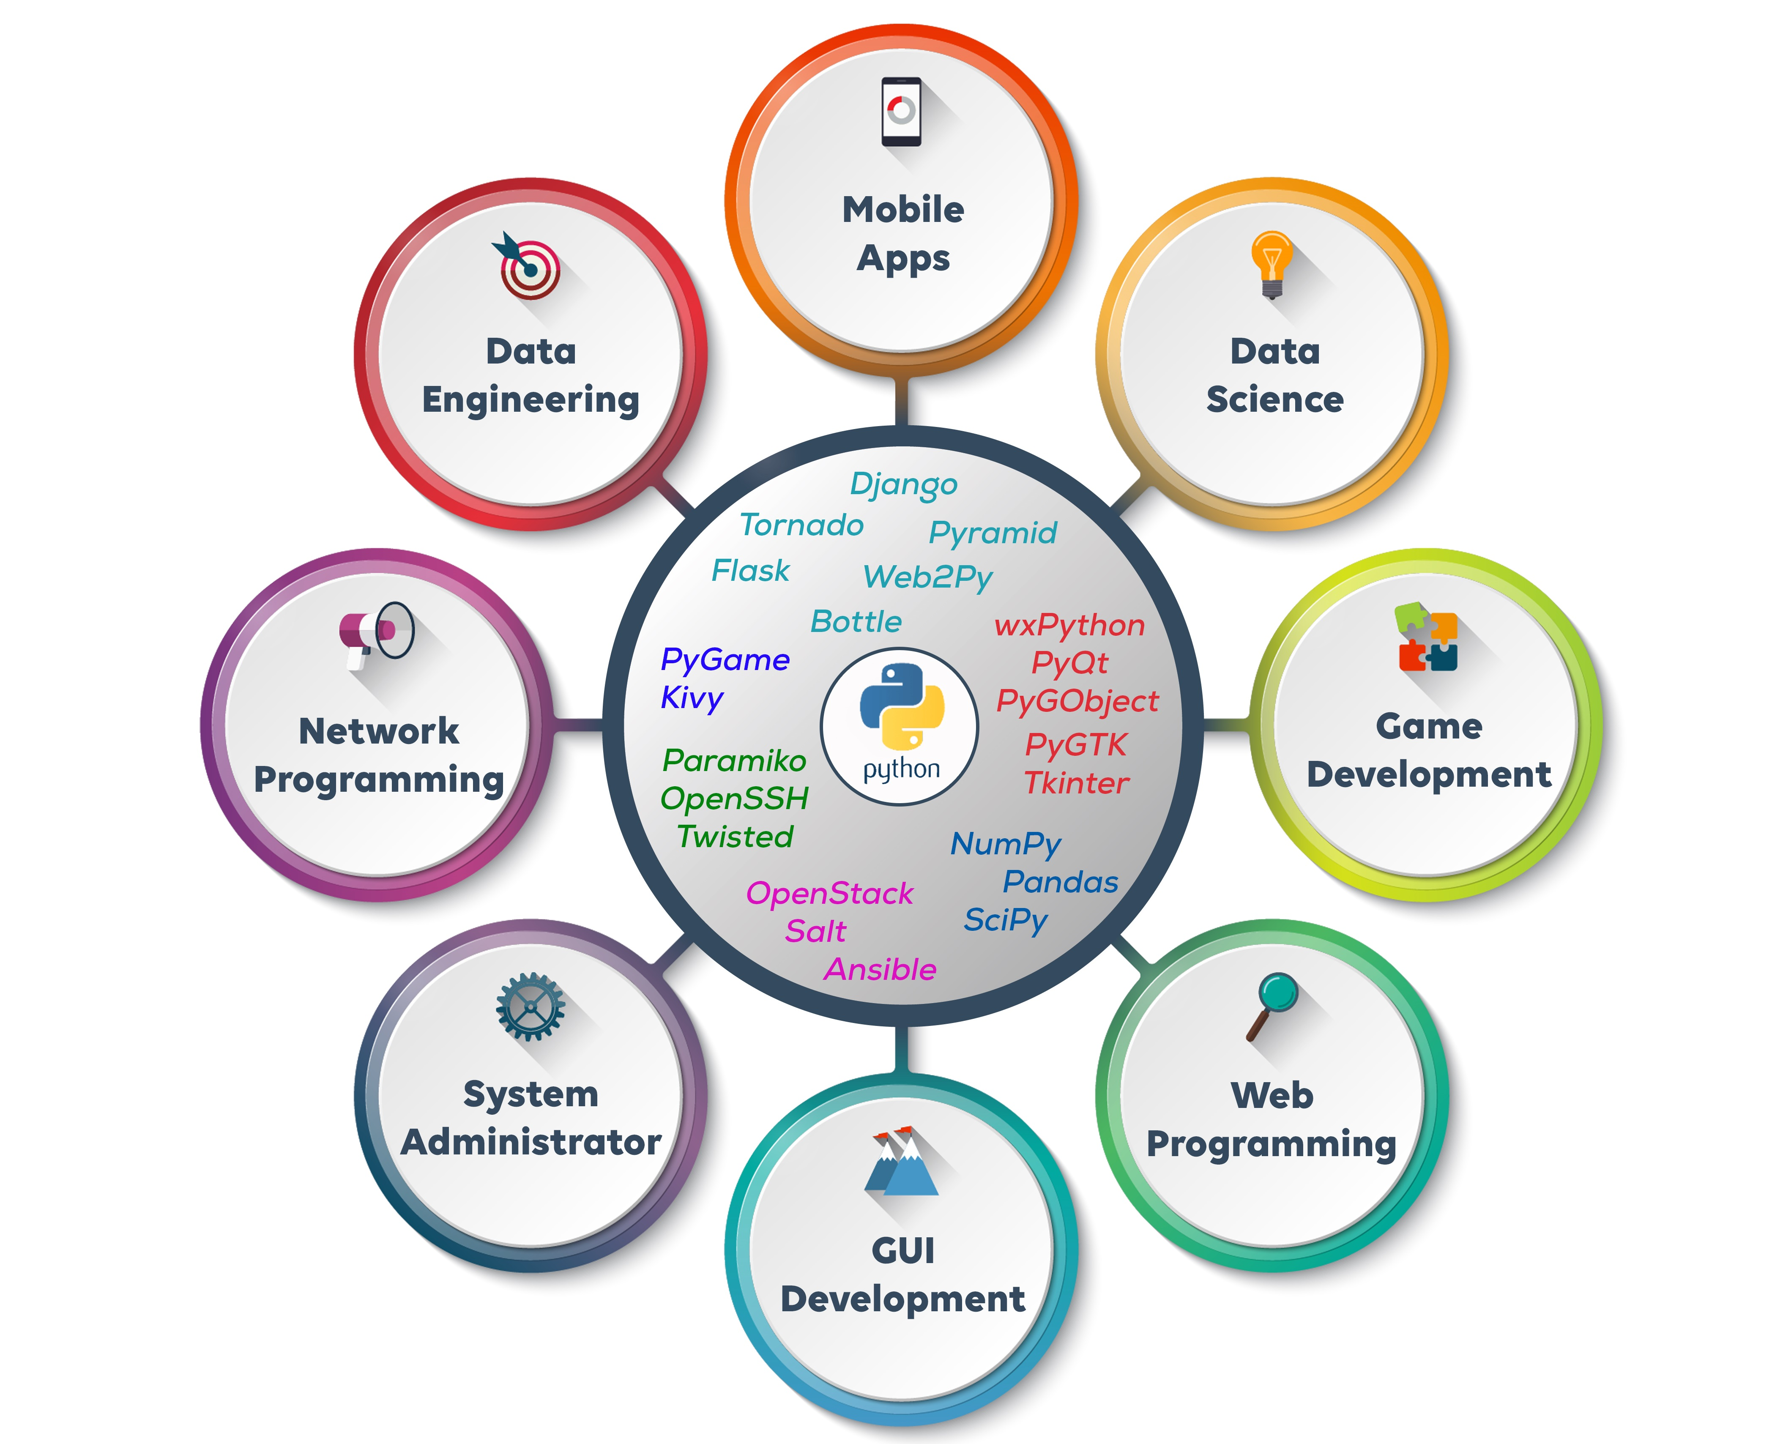
Why Python?
Figure 2. Most popular programming languages
Source: Statista
Figure 3. Python applications
Source: Celestial systems

Slide 7
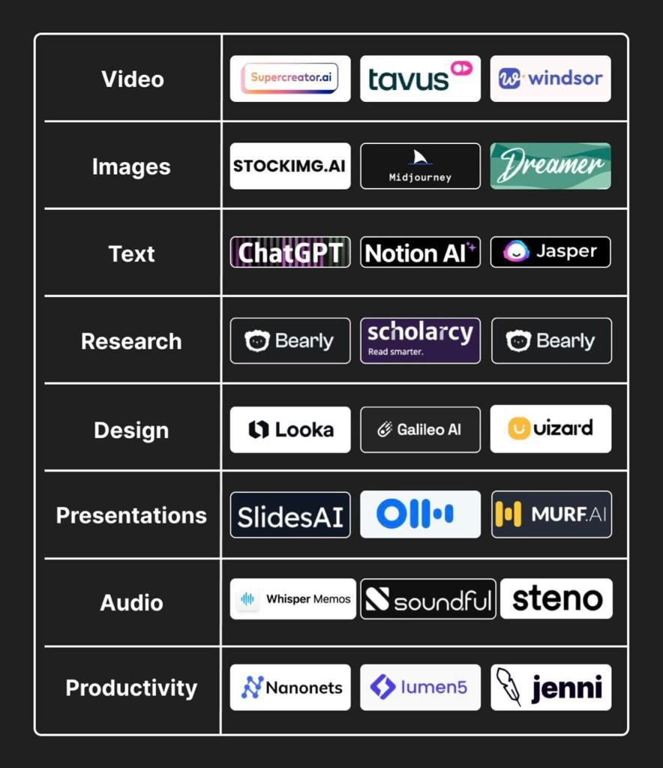

Why Python?
Figure 4. Image created with AI
Source: Midjourney

Slide 8
Why Python?
Open source
Huge community
Easy sintax

Slide 9
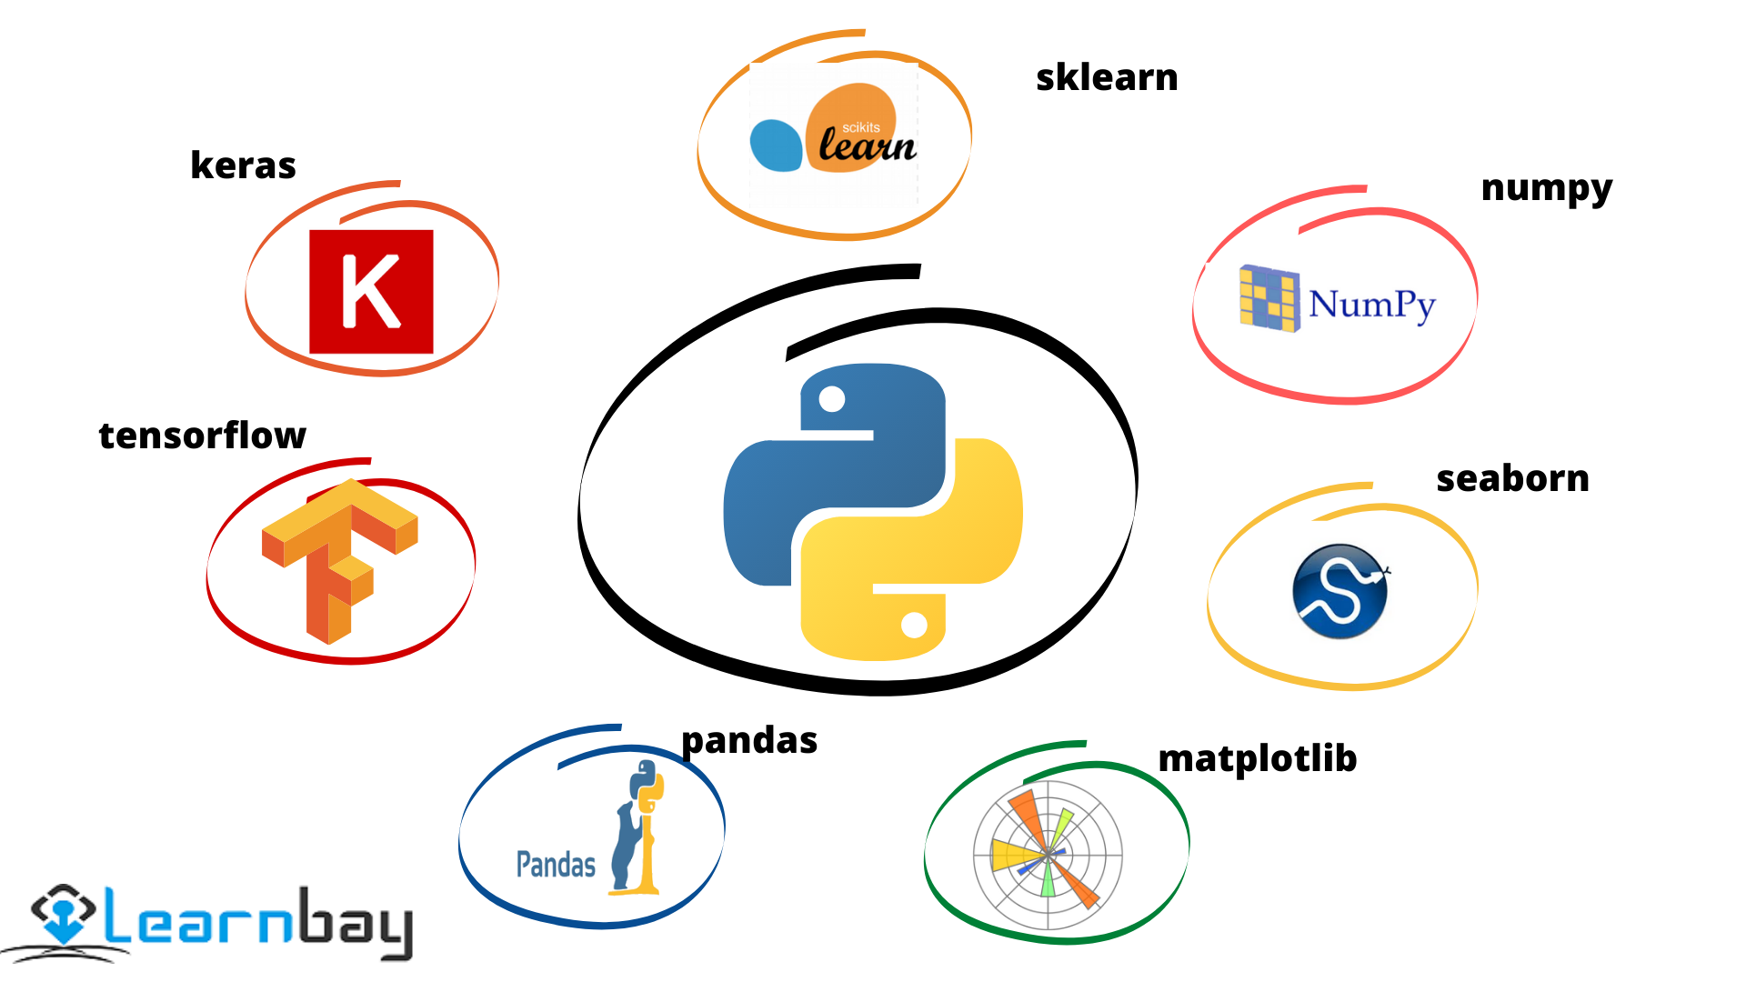
Python Libraries

Slide 10
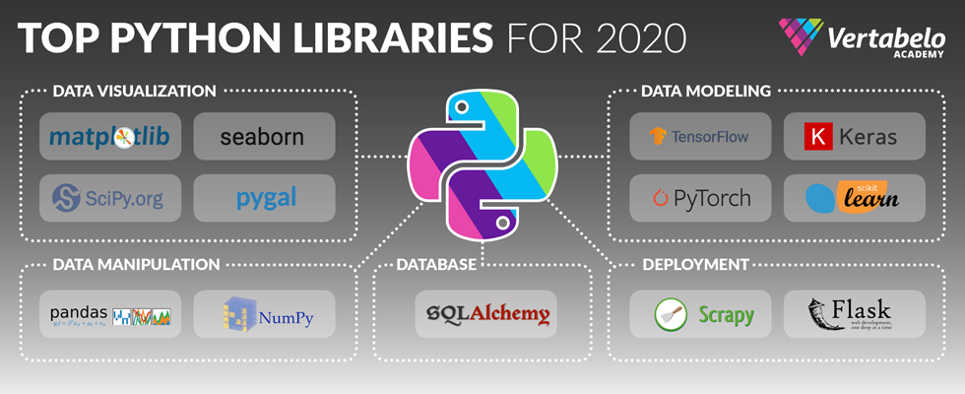
Python Libraries
Python Libraries are a set of useful functions that eliminate the need for writing codes from scratch. There are over 137,000 python libraries present today.

Slide 11
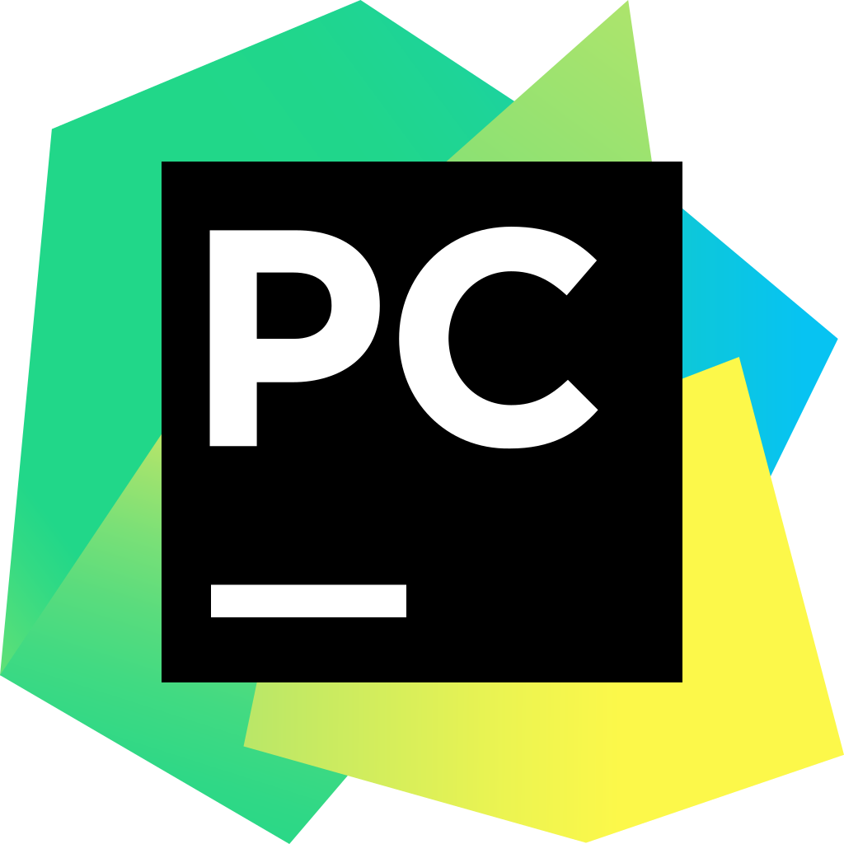

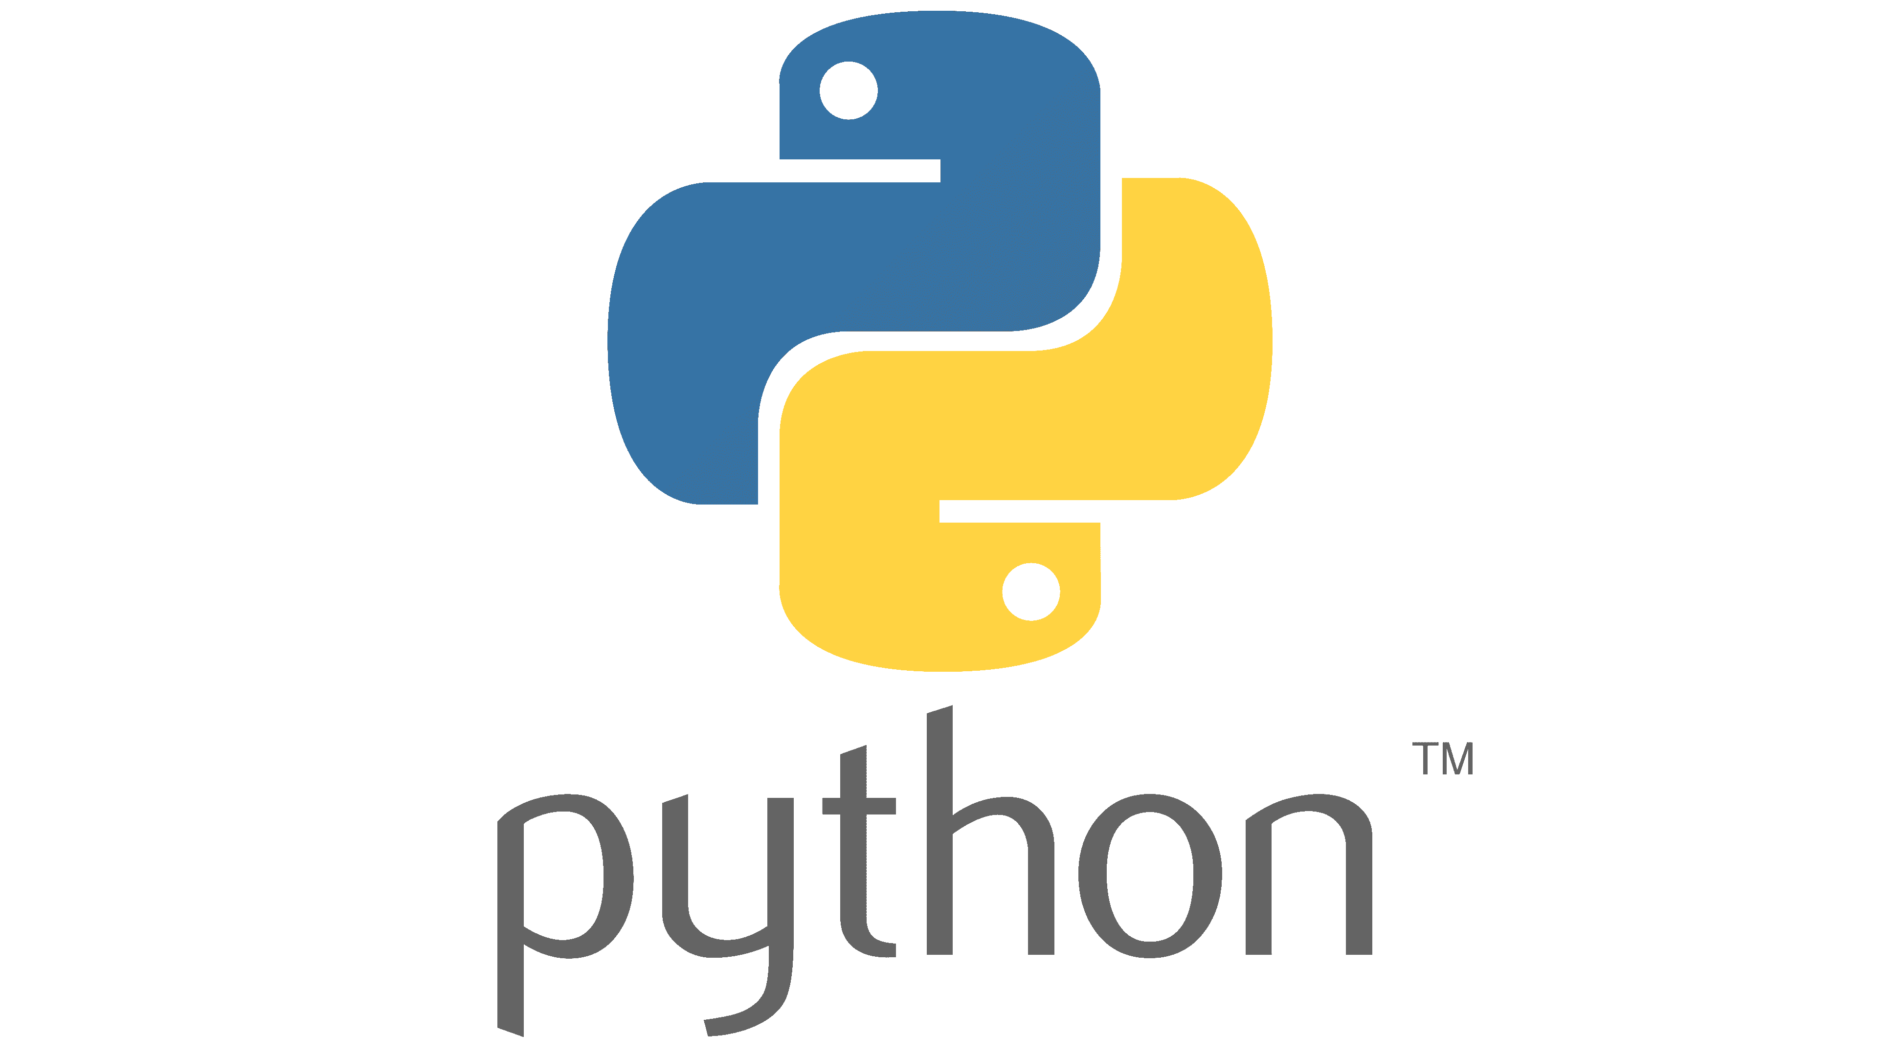
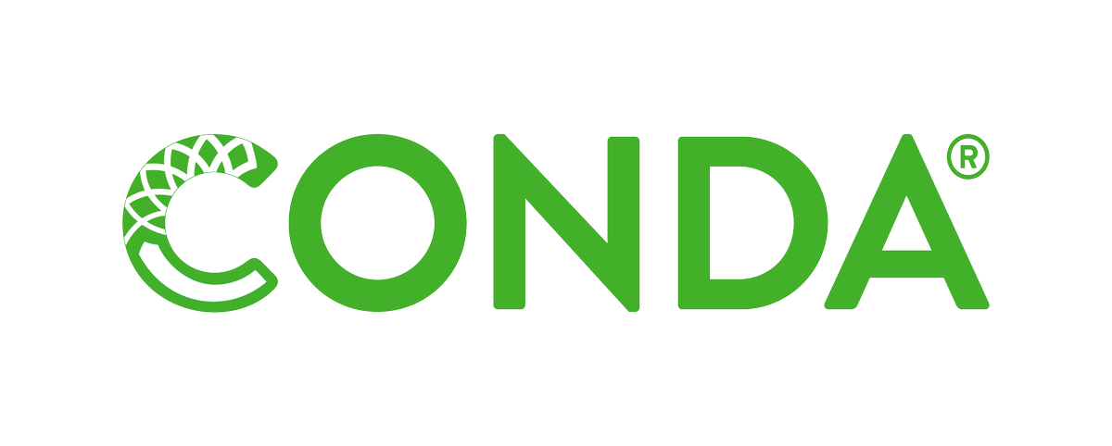
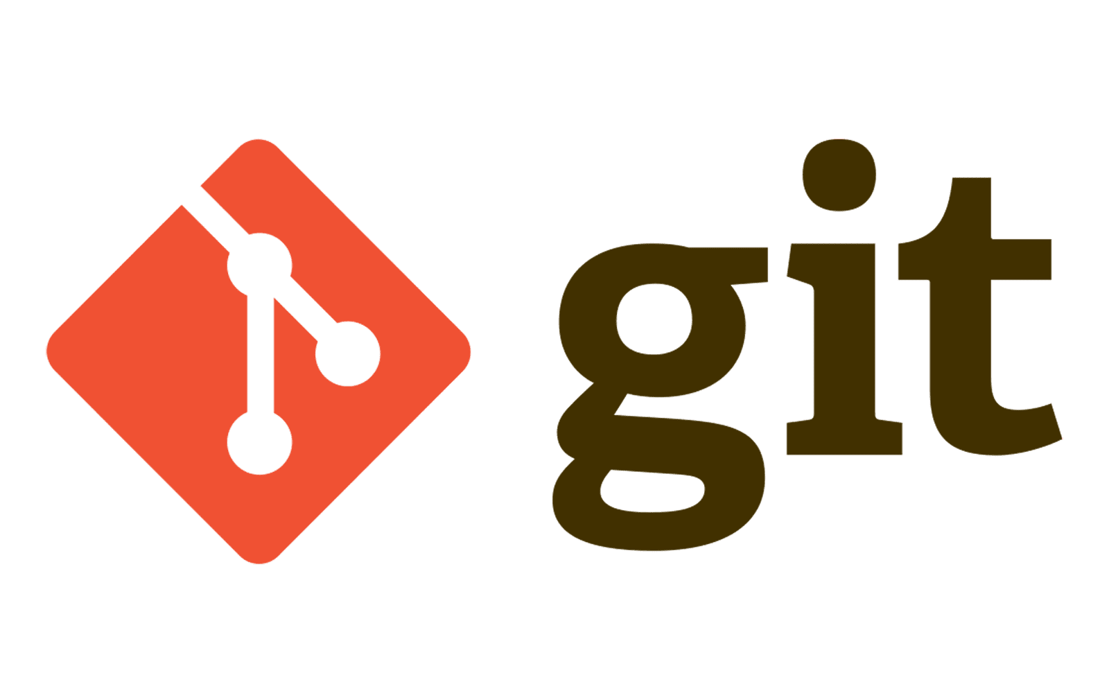
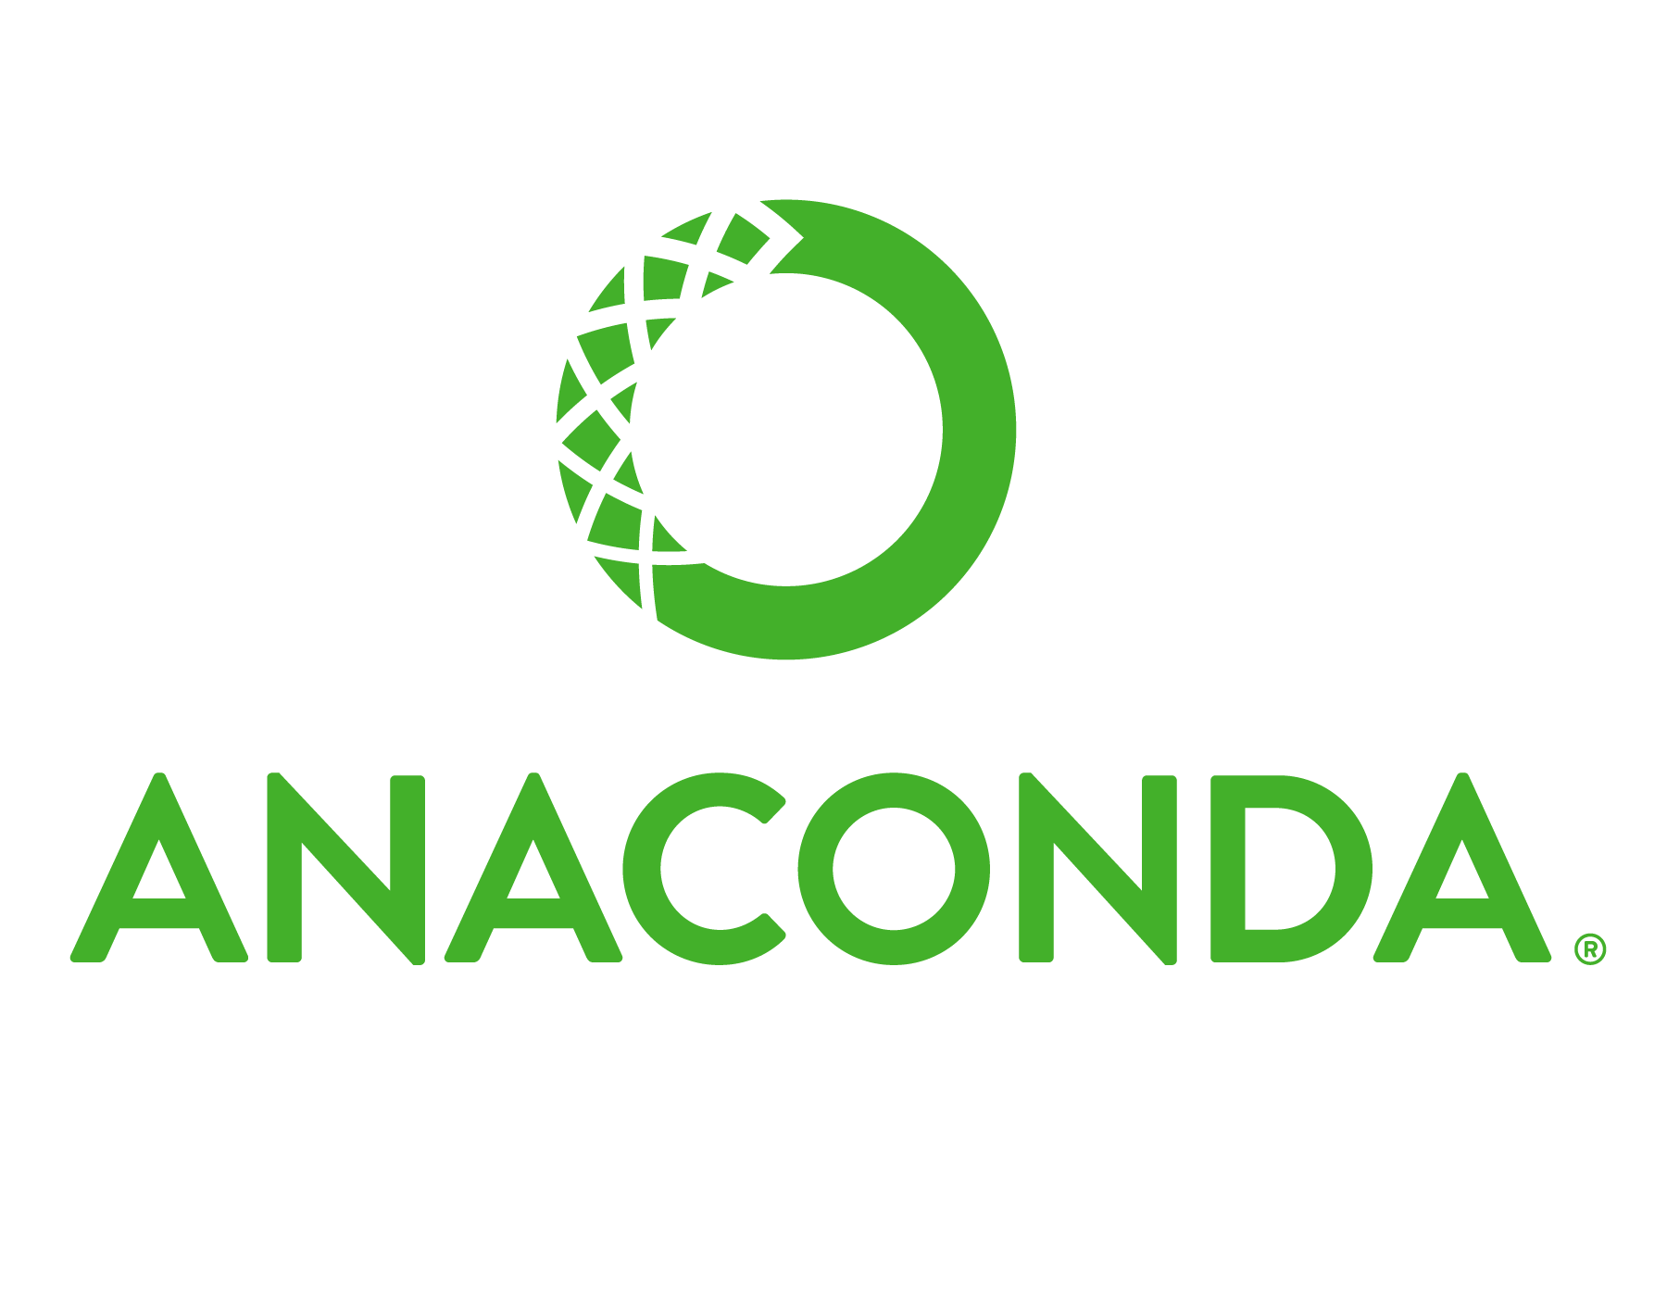
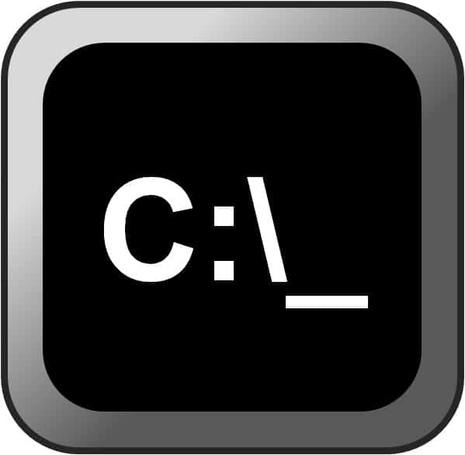

Project Setting
Pycharm
Sistema de control de versionamiento (git)
Python
IDE
Ambiente virtual
Jupyter

Slide 12
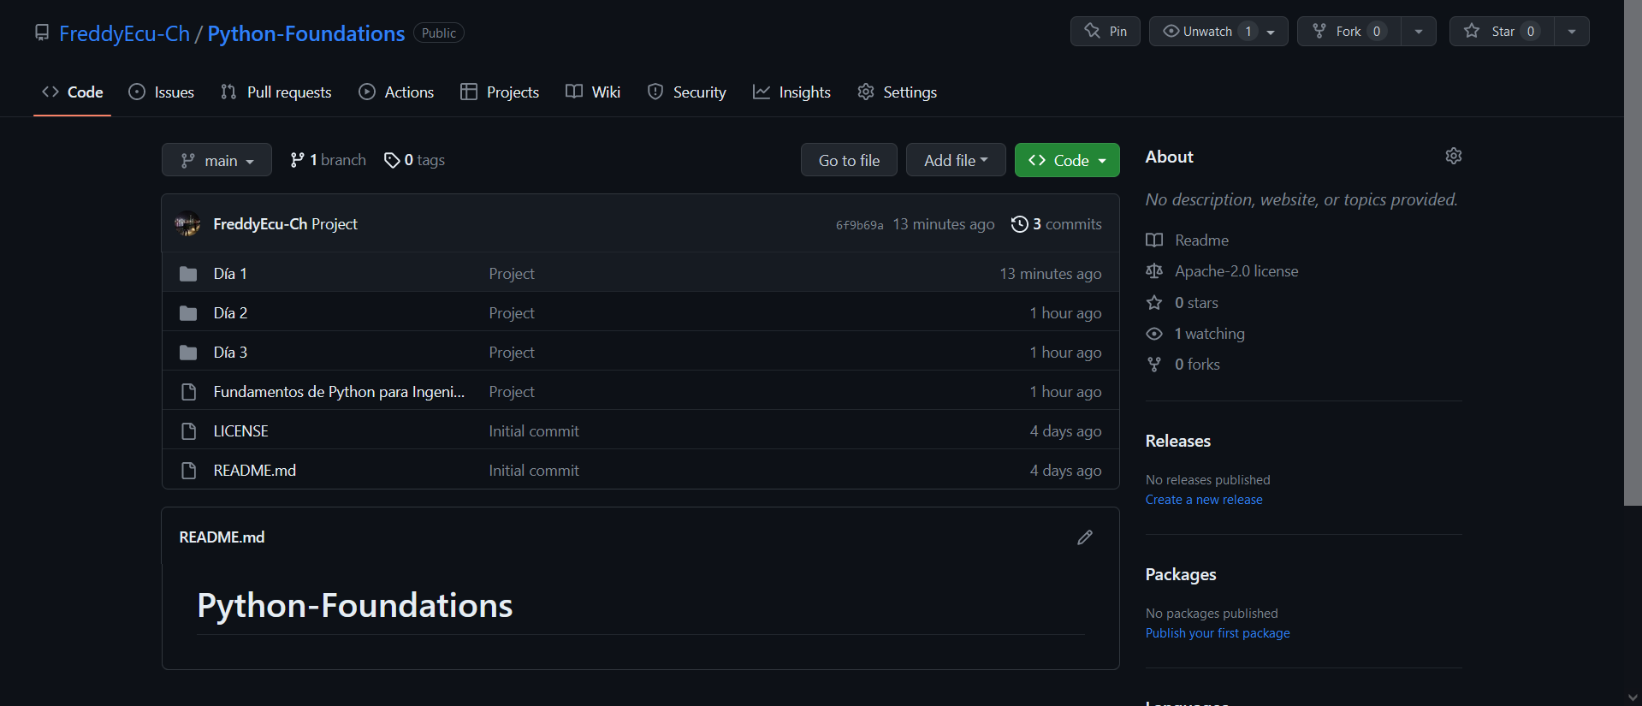
Project
Repository

